Slide 1

Pinging Between Worlds: Training Table Tennis Novice Players in Real Environment for Virtual Reality Competitions.
Sunday K., Li, Y., Sun, J., Heather N., RR Wehbe, Batmaz, A.U & Machuca, M. D. B.

Slide 2
Outline
Introduction
Motivation
Methodology
Discussion
Recommendation
Limitation
Conclusion

Slide 3
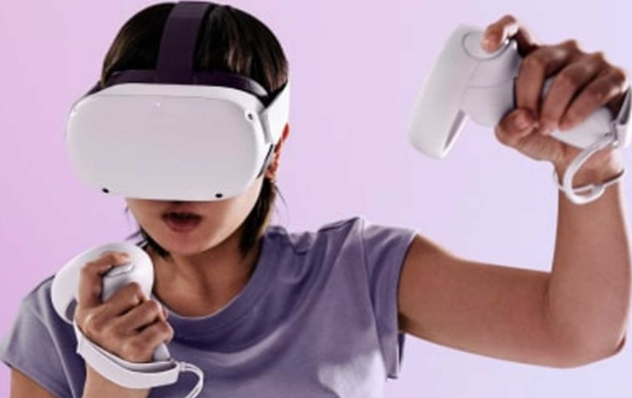
Introduction
VR is becoming a mainstream technology
Modern VR HMD offers a realistic experience in terms of graphics and tracking.
Meta VR HMD has sold over 20 million devices
Allure of gaming driving VR HMD adoption
https://www.radiotimes.com/technology/gaming/is-meta-quest-2-worth-it/

Slide 4
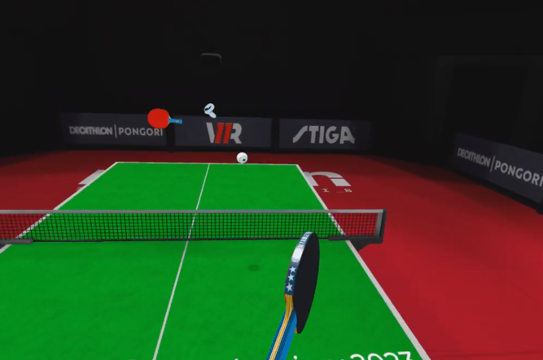
VR Table Tennis
VR table tennis is popular in VR.
Eleven Table Tennis (ETT) has a substantial user community – 298,000 players
Same rules as table tennis (two or four-players use a paddle to volley a ball across a table)

Slide 5
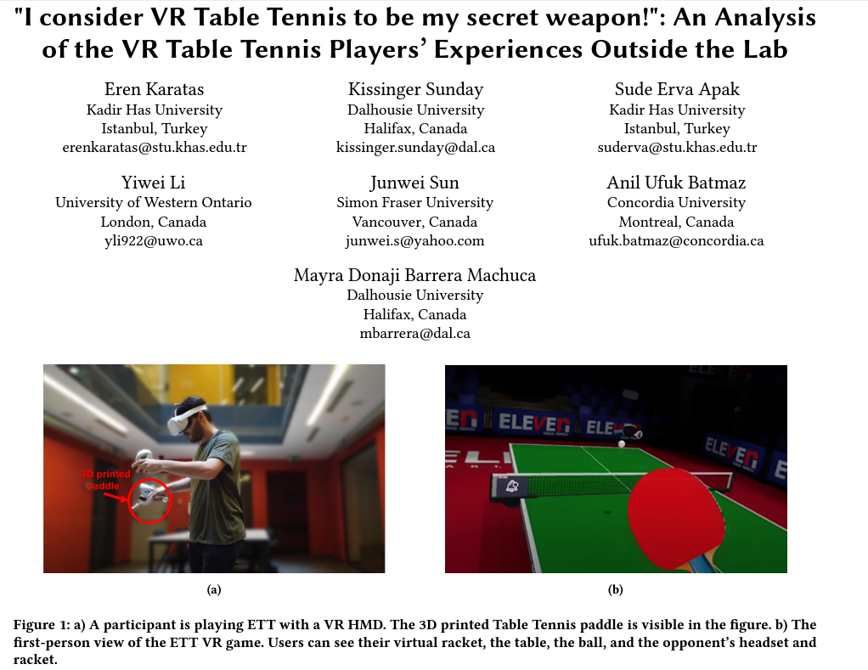
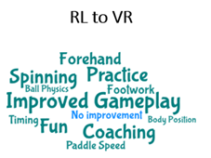
Motivation
"Eleven is a great game, but it is only 95% realistic. You can feel the ball in RL, and touch shots / short game is more predictable.“ P42
Karatas, E., Sunday, K., Apak, S. E., Li, Y., Sun, J., Batmaz, A. U., & Barrera Machuca, M. D. (2023, October). " I consider VR Table Tennis to be my secret weapon!": An Analysis of the VR Table Tennis Players' Experiences Outside the Lab. In Proceedings of the 2023 ACM Symposium on Spatial User Interaction (pp. 1-12).

Slide 6
Research Questions
RL Training
01
Skill trained in RL and transfer to VR
02
Technological Challenges in VR

Slide 7
Study Design
Participants (18-34) Male=7, Female=5 | Recruited total sample of 17 15 included in our sample as 2 failed the skill test. 12 included for analysis – 20% attrition rate
01
Eligibility Criteria
Participants needed to have never played VR table tennis
Played RL table tennis less than once a month
03
02
Passed a skill test

Slide 8
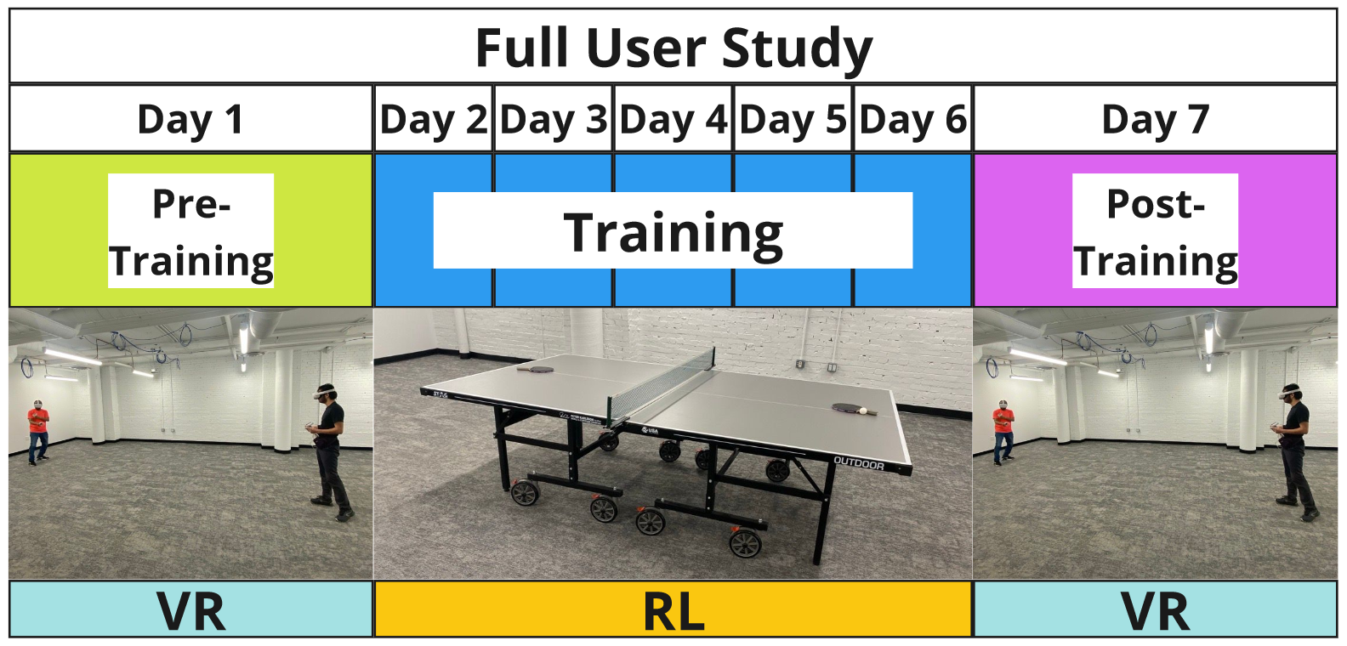
Training Sessions
TRAINING PROTOCOL
Procedure – 4 Groups of 3

Slide 9
TRAINING PROTOCOL FOR NOVICE PLAYERS
2
3
4
Warm up, Spinning, Consistency, Accuracy
Warm up, , Forehand, Backhand, Consistency, Accuracy
Warm-up, Footwork, in-out, side to side drill
Warm up, Short serve, Long serve, Consistency, Accuracy
All skills, Gameplay
1
5

Slide 10
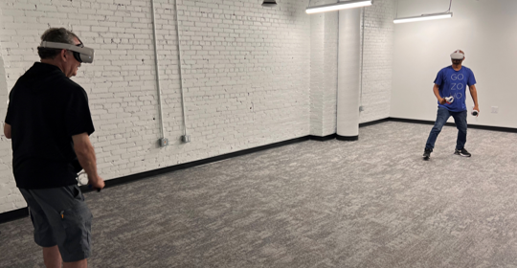
EVALUATION METRICS
Forehand, Backhand, Footwork, Short serve,
long serve
Consistencies, Spinning & Accuracies

Slide 11
Results
RQ1: What skills can be trained in RL and transferred to VR table tennis?
Strokes (Forehand, Backhand Short serve, Long serve, Spinning) Significant
Accuracy Significant
Consistency Significant
Footwork. Significant
Benjamin Hochberg Procedure. Significant

Slide 12
Results
SSQ (Mean=1.42, SD=0.67)
PACES-8 (Mean=6.4, SD=0.67)
IPAQ-SF (Mean=6.4, SD=0.67)
Immersion (ITQ) (Mean=5.83, SD=0.83)

Slide 13
Qualitative Results
Limitations in playing table tennis in VR
Technology Issues
“The graphic glitches sometimes”. (P2)
Haptic Feedback
Ball Control
Depth Perception
..sometimes, with low pressure, it takes more power compared to real life. (P1)
..lack of feedback when hitting the ball (especially in spinning)
. (P5)
‘depth perception issues and the physical discomfort of wearing VR HMDs’. (P7)

Slide 14
Qualitative Results
Limitations in playing table tennis in RL
Difficulty finding opponent in RL
“it needs a room for a table and when you go to the gym, you also need to share with another person for a table and also need a similar level friend to play”. (P7)
Space
Picking up balls
Adjust Table Height
` A separate large room and a physical table is required.’ (P5)
“Going to go pick up the ping pong balls”. (P2)
“Height is also a limitation, in VR I was able to change the height of the table.” (P1)

Slide 15
Qualitative Results
Effect of RL Training on VR Performance
Improved Footwork
“Playing in RL helped me understand my movement and footwork”. (P2)
Improved Stamina &Ball Control
Better Reaction Time
Improved Performance
“..table tennis makes me have better stamina and helps me in ball control”. (P5)
` Playing table tennis in real life helped me react better to what is going on in the game’. (P1)
`I am able to improve in all skills.'
(P7)

Slide 16
Qualitative Results
Perception of Skill Transfer to VR
Basic Skills
“Basic table tennis improvement”
(P2)
Consistency
Spinning Difficulty
“I became more consistent when pulling the ball”. (P5)
' Spinning the ball in VR is hard.'
(P1)

Slide 17
DISCUSSION
RQ1: How do different training environments affect VR table tennis skill transfer?
RQ1: Basic Table Tennis Skills Improvement
RQ2: Identified VR Technology Limitations

Slide 18
RECOMMENDATION
Integrate RL Training as
Supplementary to VR Training
Follow Training Protocols
Produced in RL to Improve VR Training
1
3
Mitigate VR Limitations
for Playability and Accessibility
5
2
Focus on
User-Centered Design
4
6
Optimize Game Physics
with Concentration on the Ball
Incorporate Virtual Coach and Training Protocol for VR Training Applications in Real-time

Slide 19
LIMITATIONS
Focus solely on Novice Players
External Validity
Lack of Multiple Raters

Slide 20
Conclusion
I conducted a longitudinal user study with pre- and post-training stages, involving novice Virtual Reality (VR) Players.
Benefits of RL training on novice players’ performance and transfer to VR

Slide 21
Related Publications
Sunday K., Li, Y., Sun, J., Heather N., RR Wehbe, Batmaz, A.U & Machuca, M. D. B. 2024. Pinging Between Worlds: Evaluating Real-life Training for Virtual Reality Competitions. International Symposium on Mixed and Augmented Reality (ISMAR) - ACCEPTED.
Karatas, E., Sunday, K., Apak, S. E., Li, Y., Sun, J., Batmaz, A. U., & Barrera Machuca, M. D. (2023, October). I consider VR Table Tennis to be my secret weapon!: An Analysis of the VR Table Tennis Players' Experiences Outside the Lab. In Proceedings of the 2023 ACM Symposium on Spatial User Interaction (pp. 1-12).
Kissinger Sunday,

Slide 22
Other Publications
Turkmen, R., Nwagu, C., Rawat, P., Riddle, P., Sunday, K., & Machuca, M. B. (2023, March). Put your glasses on: A voxel-based 3D authentication system in VR using eye-gaze. In 2023 IEEE Conference on Virtual Reality and 3D User Interfaces Abstracts and Workshops (VRW) (pp. 947-948). IEEE.
Rawat, P., Turkmen, R., Nwagu, C., Sunday, K., & Machuca, M. D. B. (2024, March). Evaluating Voxel-Based Graphical Passwords for Virtual Reality. In 2024 IEEE Conference on Virtual Reality and 3D User Interfaces Abstracts and Workshops (VRW) (pp. 12-17). IEEE.
Graphics Interface, 2024 (Poster –Non-archival) - Kissinger Sunday, Poppy Riddle, Razan Amur Hamood Al Habsi, Jiaxiong Yao, Derek Reilly, Mayra Donaji Barrera Machuca.
Kissinger Sunday,

Slide 23

Thanks for Listening
Any Questions?

